Slide 1
Exploring Assumptions
Prof. Andy Field

Slide 2
Aims
Assumptions of parametric tests based on the normal distribution
Understand the assumption of normality
  Graphical displays
  Skew
  Kurtosis
  Normality tests
Understand homogeneity of variance
  Levene’s test
Know how to correct problems in the data
  Log, square root and reciprocal transformations
  Pitfalls and alternatives
  Robust tests

Slide 3
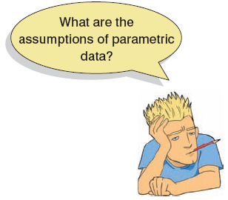
Assumptions
Parametric tests based on the normal distribution assume:
  Normally distributed
    Sampling distribution
    Residuals
  Homogeneity of variance
  Interval or ratio level data
  Independent scores

Slide 4
Assessing Normality
We don’t have access to the sampling distribution so we usually test the observed data
Central limit theorem
  If N > 30, the sampling distribution is normal anyway
Graphical displays
  Q-Q plot (or P-P plot)
  Histogram
Values of skew/kurtosis
  0 in a normal distribution
  Convert to z (by dividing value by SE)
Kolmogorov-Smirnov test
  Tests if data differ from a normal distribution
  Significant = non-normal data
  Non-significant = normal data

Slide 5
Normality Example
A biologist was worried about the potential health effects of music festivals.
Download Music Festival
Measured the hygiene of 810 concert-goers over the three days of the festival.
Hygiene was measured using a standardized technique :
  Score ranged from 0 to 4
    0 = you smell like a corpse rotting up a skunk’s arse
    4 = you smell of sweet roses on a fresh spring day

Slide 6
The Q-Q Plot
To draw a Q-Q plot of the hygiene scores for day 1 of the music festival:
  qqplot.day1 <- qplot(sample = dlf$day1, stat="qq")
  qqplot.day1
To draw a Q-Q plot of the hygiene scores for day 2 of the music festival:
  qqplot.day2 <- qplot(sample = dlf$day2, stat="qq")
  qqplot.day1

Slide 7
The Q-Q Plot
Hygiene Scores: Day 1
Hygiene Scores: Day 2
Normal
Not Normal

Slide 8
Assessing Skew and Kurtosis
Using by():
  by(data = rexam$exam, INDICES = rexam$uni, FUN = describe)
Using stat.desc():
  by(data = rexam$exam, INDICES = rexam$uni, FUN = stat.desc)
These commands have the same effect as those above:
  by(rexam$exam, rexam$uni, describe)
  by(rexam$exam, rexam$uni, stat.desc)
If we want descriptive statistics for multiple variables, then we can use cbind() :
  by(cbind(data=rexam$exam,data=rexam$numeracy), rexam$uni, describe)

Slide 9
Assessing Skew and Kurtosis
We can also use describe() and stat.desc() with more than one variable at the same time using cbind():
  describe(cbind(dlf$day1, dlf$day2, dlf$day3))
  stat.desc(cbind(dlf$day1, dlf$day2, dlf$day3), basic = FALSE, norm = TRUE)

Slide 10
Assessing Skew and Kurtosis
day1 day2 day3
median 1.790000000 7.900000e-01 7.600000e-01
mean 1.770828183 9.609091e-01 9.765041e-01
SE.mean 0.024396670 4.436095e-02 6.404352e-02
CI.mean.0.95 0.047888328 8.734781e-02 1.267805e-01
var 0.481514784 5.195239e-01 5.044934e-01
std.dev 0.693912663 7.207801e-01 7.102770e-01
coef.var 0.391857702 7.501022e-01 7.273672e-01
skewness -0.003155393 1.082811e+00 1.007813e+00
skew.2SE -0.018353763 3.611574e+00 2.309035e+00
kurtosis -0.423991408 7.554615e-01 5.945454e-01
kurt.2SE -1.234611514 1.264508e+00 6.862946e-01
normtest.W 0.995907247 9.083185e-01 9.077513e-01
normtest.p 0.031846386 1.281495e-11 3.804334e-07

Slide 11
Another Example
Performance on statistics exam
Participants
  N = 100 students
Measures
  Exam: first-year exam scores as a percentage
  Computer: measure of computer literacy, %
  Lecture: percentage of lectures attended
  Numeracy: a measure of numerical ability out of 15
  Uni: whether the student attended Sussex University or Duncetown University

Slide 12
Assessing Normality
Shapiro-Wilk test for exam and numeracy for whole sample:
  shapiro.test(rexam$exam)
  shapiro.test(rexam$numeracy)
Output:
    >Shapiro-Wilk normality test
    data: rexam$exam
    W = 0.9613, p-value = 0.004991
    >Shapiro-Wilk normality test
    data: rexam$numeracy
    W = 0.9244, p-value = 2.424e-05

Slide 13
Assessing Normality
Shapiro-Wilk test for exam and numeracy split by university:
  by(rexam$exam, rexam$uni, shapiro.test)
  by(rexam$numeracy, rexam$uni, shapiro.test)

Slide 14
Assessing Normality
Output for exam:
  rexam$uni: Duncetown University
  Shapiro-Wilk normality test
  data: dd[x, ]
  W = 0.9722, p-value = 0.2829
  -------------------------------------------------------------------
  rexam$uni: Sussex University
  Shapiro-Wilk normality test
  data: dd[x, ]
  W = 0.9837, p-value = 0.7151

Slide 15
Assessing Normality
Output for numeracy:
  rexam$uni: Duncetown University
  Shapiro-Wilk normality test
  data: dd[x, ]
  W = 0.9408, p-value = 0.01451
  -------------------------------------------------------------------
  rexam$uni: Sussex University
  Shapiro-Wilk normality test
  data: dd[x, ]
  W = 0.9323, p-value = 0.006787

Slide 16
Q-Q Plots
Normal Q-Q plots of numeracy and R exam scores

Slide 17
Assessing Homogeneity of Variance
Graphs (see lectures on regression)
Levene’s test
  Tests if variances in different groups are the same.
  Significant = variances not equal
  Non-significant = variances are equal
Variance ratio
  With 2 or more groups
  VR = largest variance/smallest variance
  If VR < 2, homogeneity can be assumed.

Slide 18
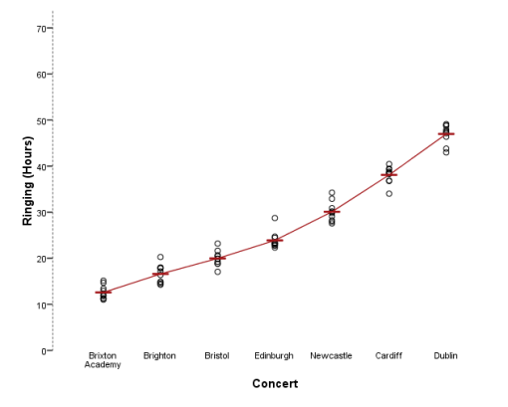
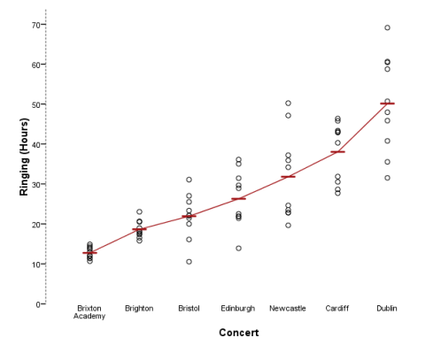
Homogeneity of Variance
Homogeneous
Heterogeneous

Slide 19
Assessing Homogeneity of Variance with R Commander

Slide 20
Assessing Homogeneity of Variance with R
Use the leveneTest() function from the car package:
  leveneTest(outcome variable, group, center = median/mean)
Levene’s test for the exam and numeracy scores:
  leveneTest(rexam$exam, rexam$uni)
  leveneTest(rexam$numeracy, rexam$uni)

Slide 21
Output for Levene’s Test
  > leveneTest(rexam$exam, rexam$uni)
  Levene's Test for Homogeneity of Variance (center = median)
  Df F value Pr(>F)
  group 1 2.0886 0.1516
  98
  > leveneTest(rexam$numeracy, rexam$uni)
  Levene's Test for Homogeneity of Variance (center = median)
  Df F value Pr(>F)
  group 1 5.366 0.02262 *
  98

Slide 22
Correcting Data Problems
Log transformation (log(X_{i}))
  Reduce positive skew.
Square root transformation (√X_{i}):
  Also reduces positive skew. Can also be useful for stabilizing variance.
Reciprocal transformation (1/ X_{i}):
  Dividing 1 by each score also reduces the impact of large scores. This transformation reverses the scores; you can avoid this by reversing the scores before the transformation, 1/(X_{Highest} – X_{i}).

Slide 23
Correcting Data Problems
Log transformation:
  dlf$logday1 <- log(dlf$day1)
  dlf$logday1 <- log(dlf$day1 + 1)
Square root transformation:
  dlf$sqrtday1 <- sqrt(day1)
Reciprocal transformation:
  dlf$recday1 <- 1/(dlf$day1 + 1)

Slide 24
The Effect of Transformations
Distributions of the hygiene data on day 1 and day 2 after various transformations

Slide 25

To Transform … Or Not
Transforming the data helps as often as it hinders the accuracy of F (Games & Lucas, 1966).
Games (1984):
  The central limit theorem: sampling distribution will be normal in samples > 40 anyway.
  Transforming the data changes the hypothesis being tested
    E.g. when using a log transformation and comparing means, you change from comparing arithmetic means to comparing geometric means
  In small samples it is tricky to determine normality one way or another.
  The consequences for the statistical model of applying the ‘wrong’ transformation could be worse than the consequences of analysing the untransformed scores.

Slide 26

Robust Methods: Examples
 | Comparing Treatments | Relationships
Principle | Bootstrap | Bootstrap
 | Trimmed means | Least trimmed squares
 | M-estimators | M-estimators
 | Median | Least median of squares
Equivalent Tests | t-test | Correlation
 | ANOVA (including factorial) | Regression
 | ANCOVA | ANCOVA
 | MANOVA

